Slide 1



Digital Signage by SpinetiX
06.09.2021

Slide 2
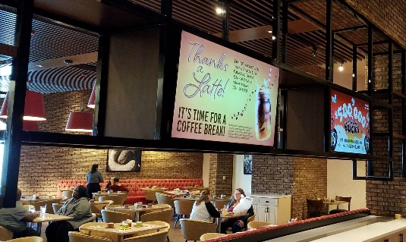
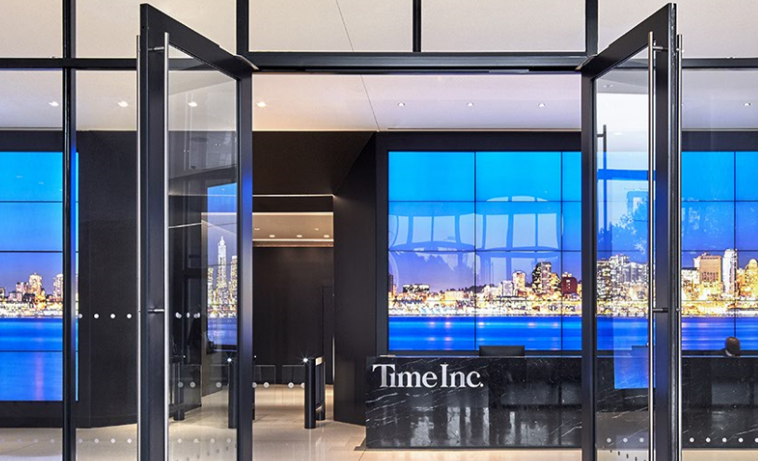
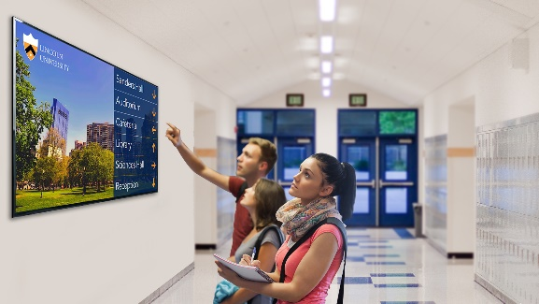
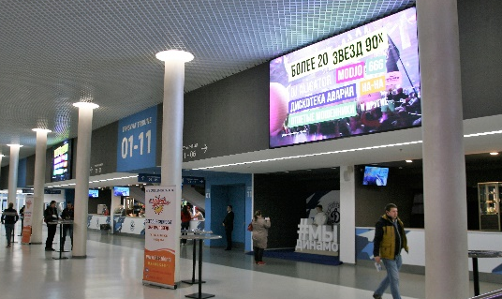
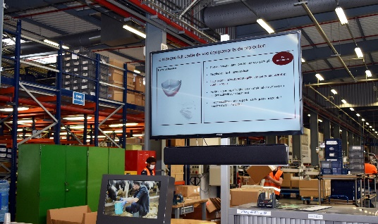
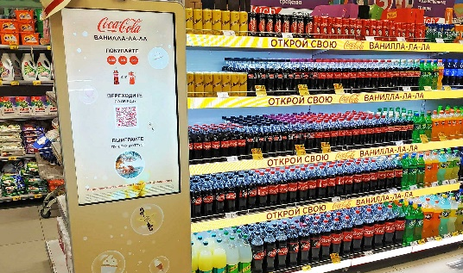

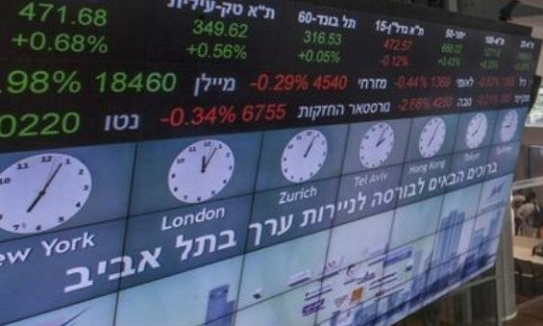
Digital Signage is Everywhere
Hospitality
Corporate
Education
Events & Entertainment
Entertain & Create Experiences
Impress, Impact & Differentiate
Educate & Reach a larger audience
Create Memorable Emotions
Production sites
Retail
Institutions & Government
Financial Services
Save time & Increase safety
Personalize, Cross-sell & Earn more
Inform, Alert & Protect
Capture Tomorrow’s Opportunities

Slide 3





Why SpinetiX?
15-YEAR
HERITAGE
A COLLABORATIVE ECOSYSTEM
A COMPLETE SOLUTION
Trusted and awarded
by thousands of
customers worldwide
Locally present
everywhere,
through our partners
Limitless Applications.
From simple displays
to interactive kiosks or video walls

Slide 4
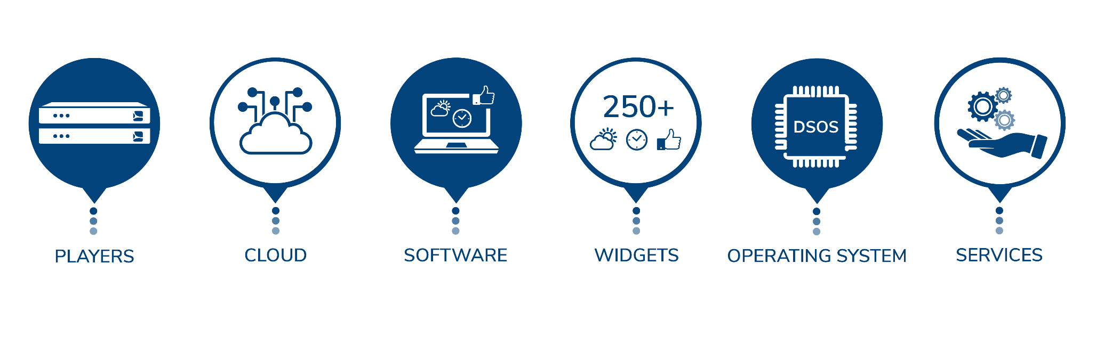
A Complete Solution for All Scenarios

Slide 5
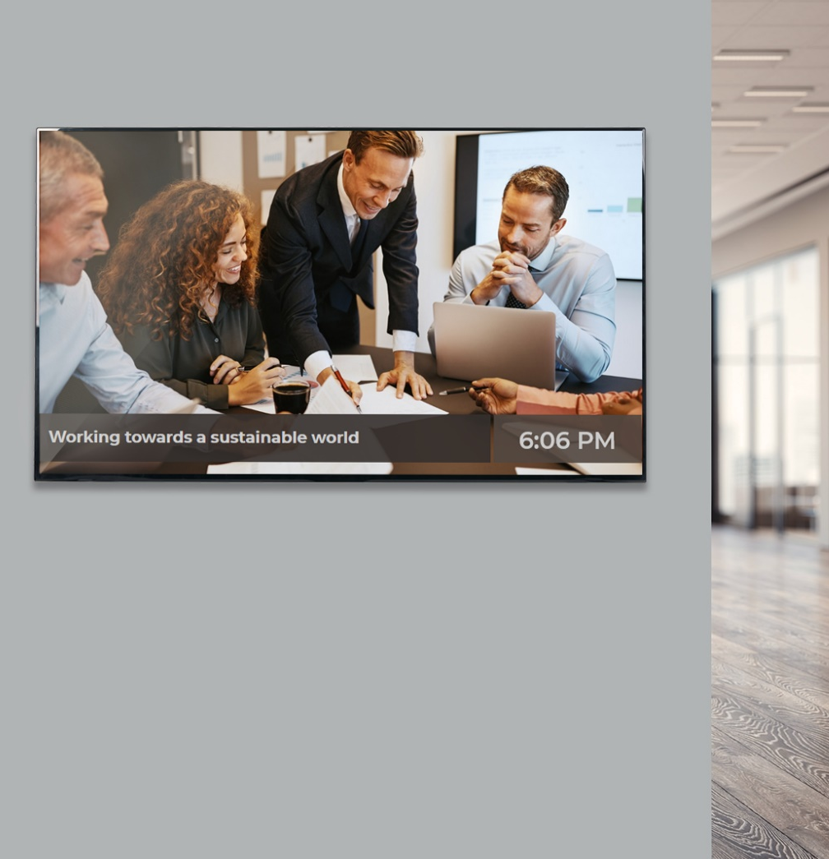
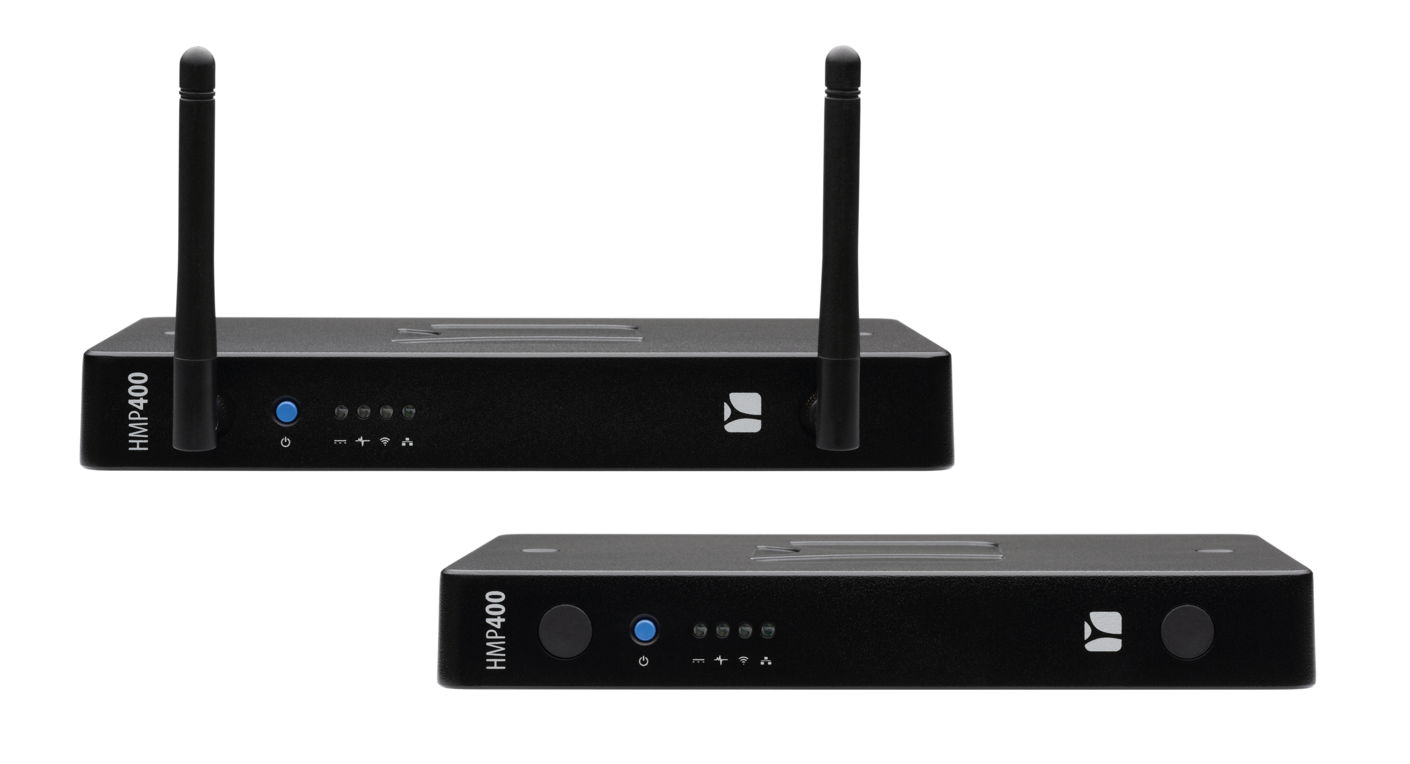
Cloud-based Scenario
+
SpinetiX ARYA
HMP400 / HMP400W
Player + SpinetiX ARYA
Intuitive by design
Visual & End-user centric
Included with all players (free cloud)
Online support chat included
And more: multi-user, tagging, services

Slide 6

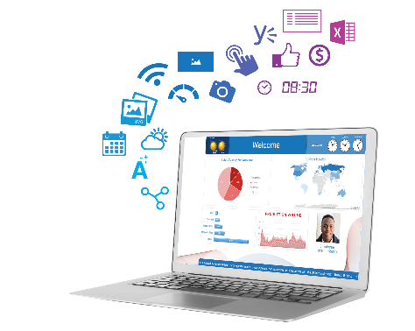
On-Premise Scenario
+
HMP400 / HMP400W
Player + Elementi Software
On-site local network deployment
No recurring fees
Advanced content customization
250+ widgets

Slide 7
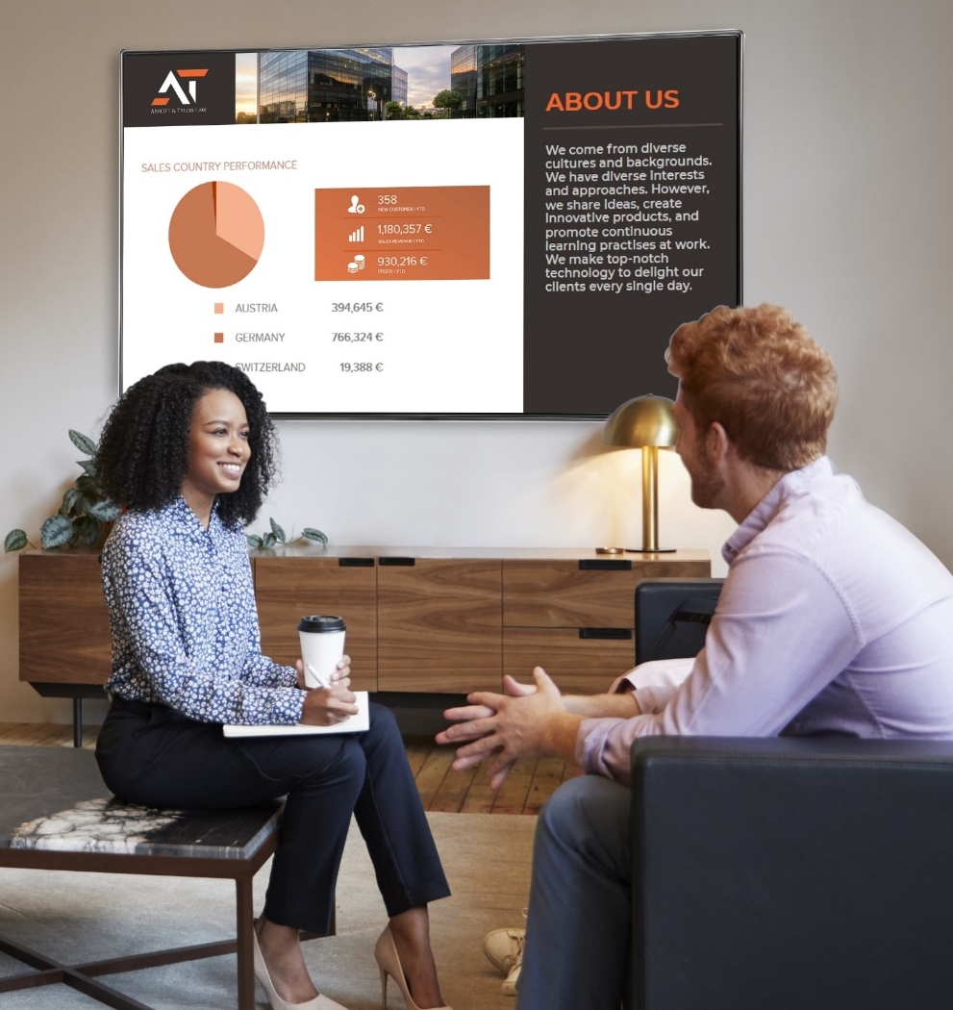

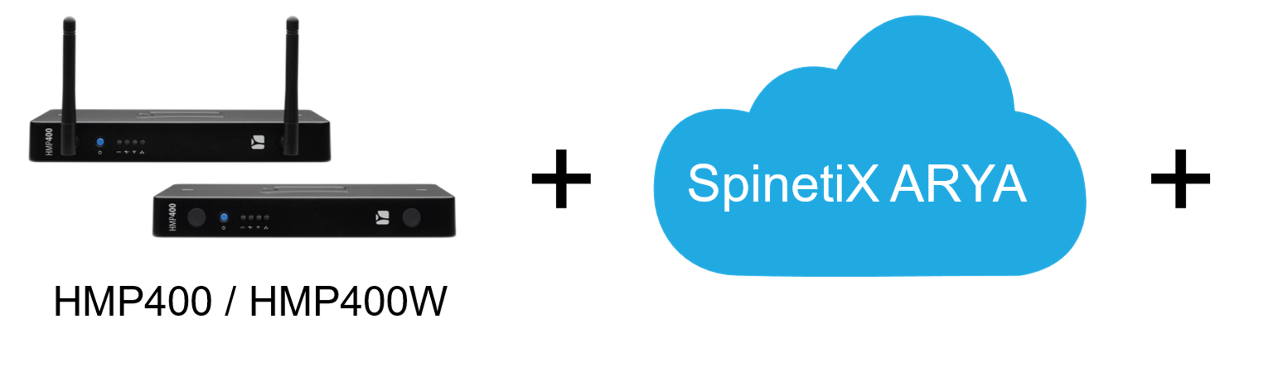
Hybrid Scenario
Player + SpinetiX ARYA + Elementi Software
Best-of-both-worlds scenario
Intuitive cloud interface from SpinetiX ARYA
Access to advanced features from Elementi software

Slide 8




Our Commitment to Your Security and Your Support
DSOS™ by SpinetiX – An Operating System Dedicated to Digital Signage
Security
at the core
Lean & easy
to maintain
Support
close to you
DSOS and Intel technology together provide a one-stop, low-risk, secure platform for digital signage deployments of any size, and any high-availability scenarios.
Designed to turn any qualified device into a dedicated signage appliance, DSOS is leaner and easier to maintain than general-purpose operating systems.
With more than a decade of experience in hardened, secure devices and operating systems, our engineering team together with trained SpinetiX partners are close to you and speak your language.
Notes:
SpinetiX offers a complete solution that allows you to add as much value as you choose. Leverage the solution to increase revenue opportunities at every level:
Plenty of service opportunities as part of the project
Integrators can add their own value and services on top of the SpinetiX solution
If you need, the ecosystem in many cases is also there to support you with their own services already in place

Slide 9
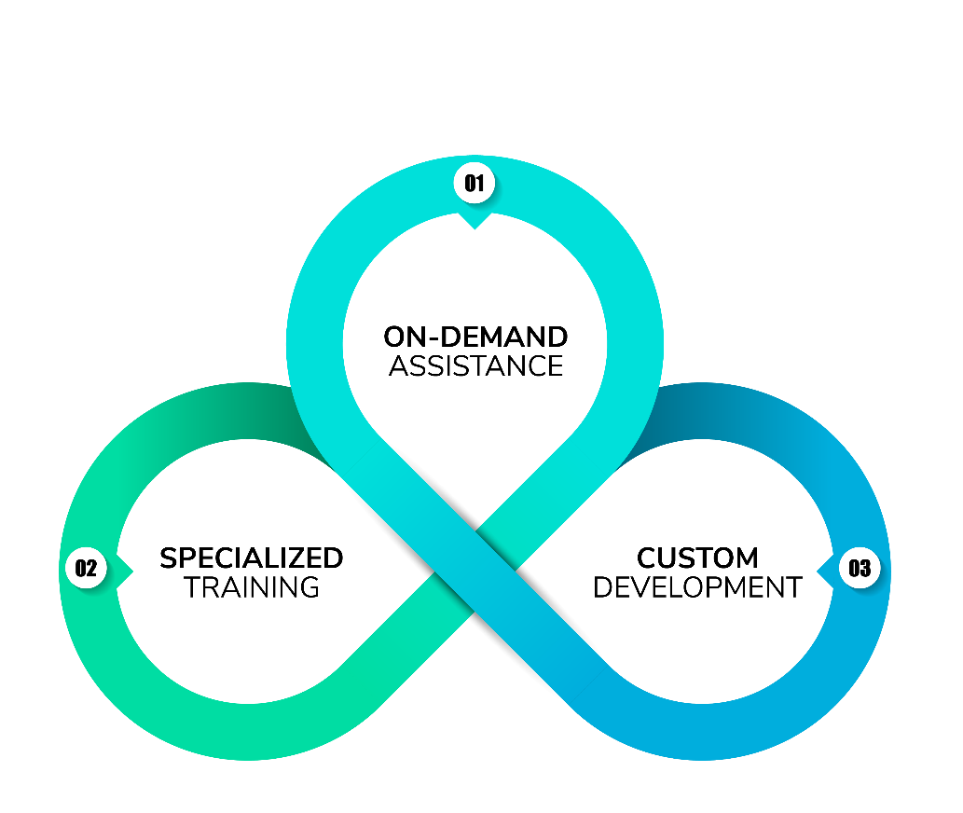
Make a Difference with Professional Services
Take part in the revenue stream
with services
Notes:
SpinetiX offers a complete solution that allows you to add as much value as you choose. Leverage the solution to increase revenue opportunities at every level:
Plenty of service opportunities as part of the project
Integrators can add their own value and services on top of the SpinetiX solution
If you need, the ecosystem in many cases is also there to support you with their own services already in place

Slide 10




Join Our Channel Ecosystem
Committed to our Channel Ecosystem through
an Indirect Distribution Model
BECOME A PARTNER

Slide 11































Our legacy
Trusted by thousands of customers worldwide.
Every continent.
Every size.
Every vertical.

Slide 12
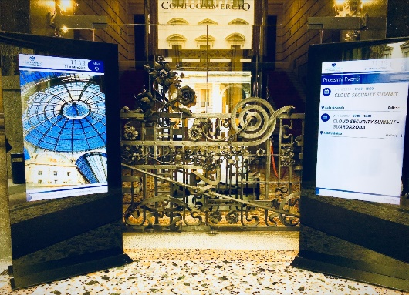
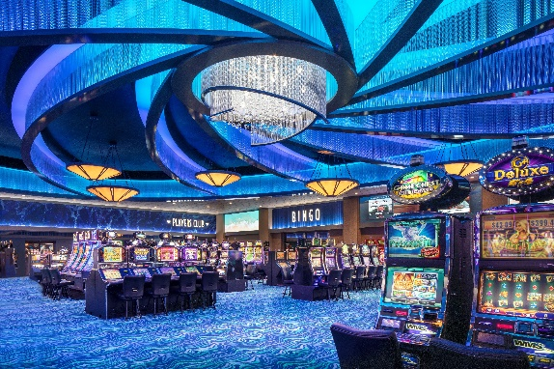
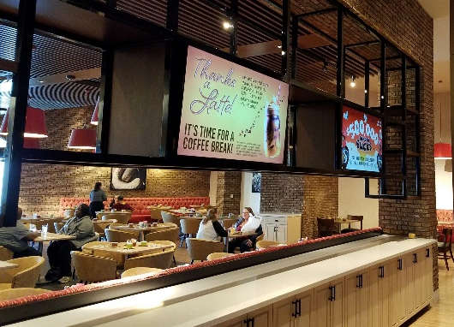
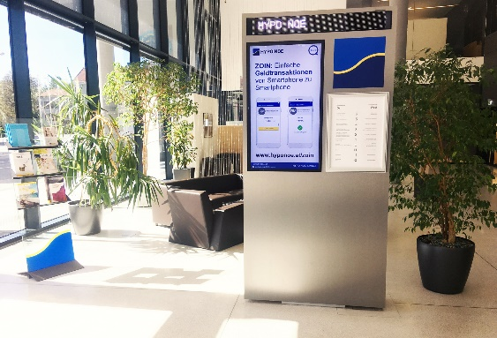
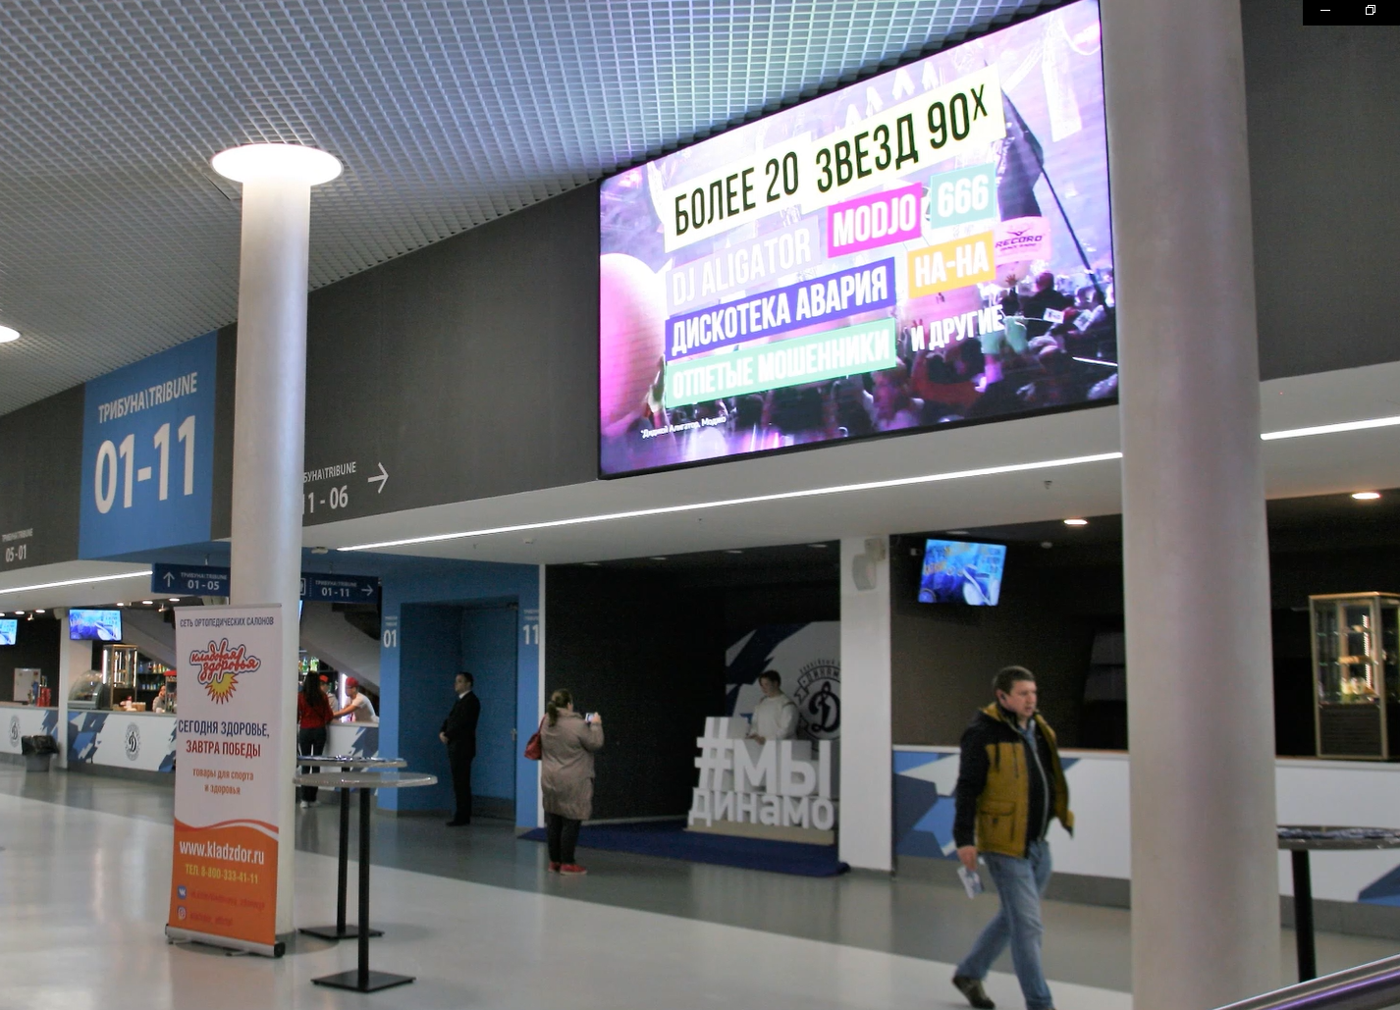
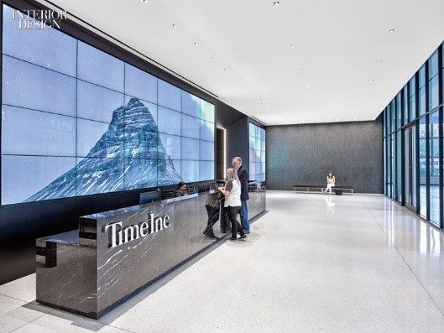
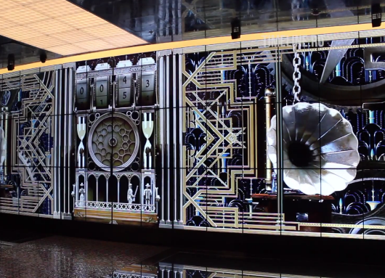
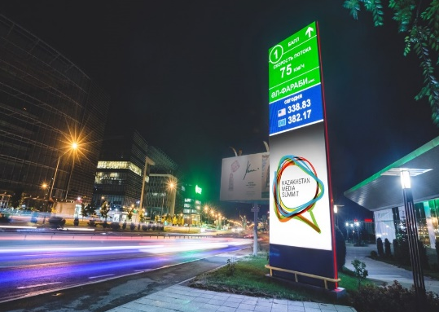
Success Stories for Every Industry
Now let’s talk about your project
sales@spinetix.com

Slide 13
Thank You!

